Slide 1
Chapter 2
Simple Linear Regression

Slide 2
Simple Linear Regression Model
Single regressor, x; response, y
β₀ – intercept: if x = 0 is in the range, then β₀ is the mean of the distribution of the response y, when x = 0; if x = 0 is not in the range, then β₀ has no practical interpretation
β₁ – slope: change in the mean of the distribution of the response produced by a unit change in x
ε - random error

Slide 3
Simple Linear Regression Model
Single regressor, x; response, y
Simple – only one predictor variable
Linear in the parameters – no parameter appears as an exponent or is multiplied by another parameter
Linear in the predictor variable – predictor variable raised to the power of one
First-order Model – linear in the parameters and the predictor variable

Slide 4
Simple Linear Regression Model
The response, y, is a random variable
There is a probability distribution for y at each value of x
Mean:
Variance:

Slide 5
Least-Squares Estimation of the Parameters
β₀ and β₁ are unknown and must be estimated
Least squares estimation seeks to minimize the sum of squares of the differences between the observed response, y_{i}, and the straight line.

Slide 6
Visualization of Least-Squares
http://www.dangoldstein.com/regression.html
library(asbio)
see.regression.tck()
rm(list=ls())
rocket <- read.delim("Data-ex-2-1 (Rocket Prop).txt",h=T)
attach(rocket)
anm.ls.reg(x, y, parameter="intercept", nmax=50, interval = 0.5, col = "red")
anm.ls.reg(x, y, parameter="slope", nmax=50, interval = 0.5, col = "red")
see.move()
see.adddel()

Slide 7
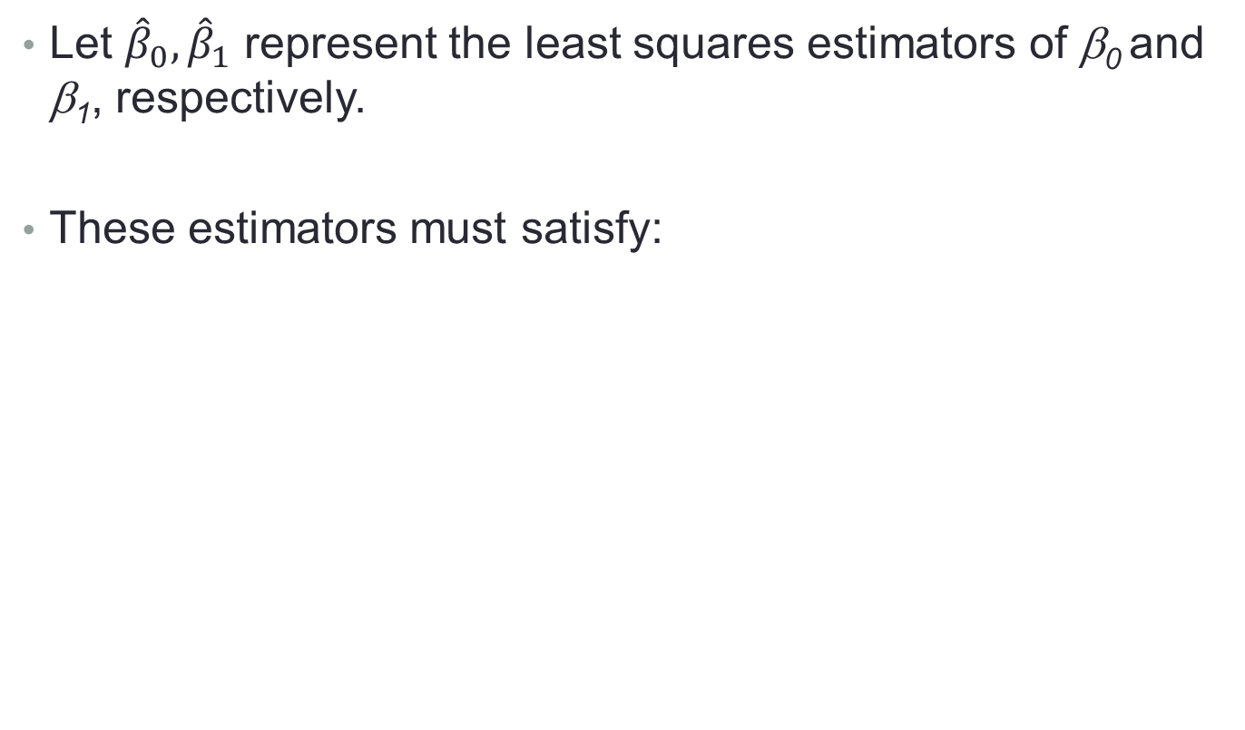
Least-Squares Estimation of the Parameters
Let ${\hat{β}}_{0},{\hat{β}}_{1}$ represent the least squares estimators of β₀ and β₁, respectively.
These estimators must satisfy:

Slide 8
Least-Squares Estimation of the Parameters
Solving the normal equations yields the ordinary least squares estimators:

Slide 9
Least-Squares Estimation of the Parameters
The fitted simple linear regression model:
Fitted value (predicted value):

Slide 10
Least-Squares Estimation of the Parameters
Residuals:
Residuals will be used to determine the adequacy of the model

Slide 11
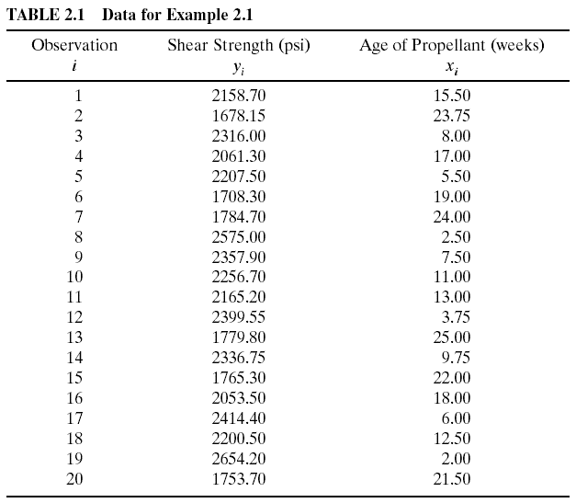
The Rocket Propellant Data

Slide 12
Now let’s analyze real data
Rocket

Slide 13
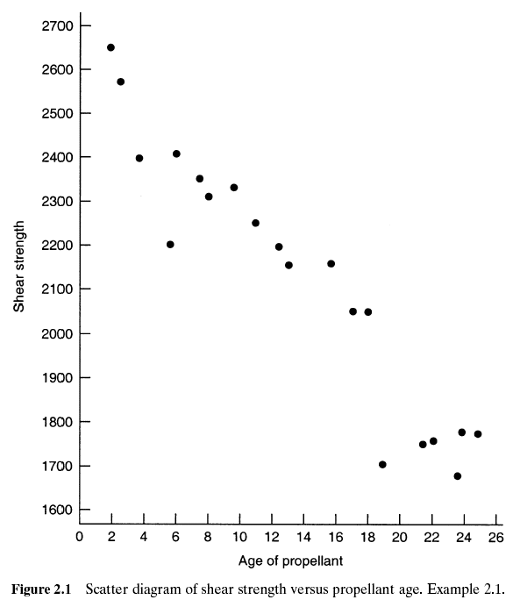
The Rocket Propellant Data

Slide 14
R
getwd()
setwd("E:/qyc_dropbox_win/Dropbox/qyc_doc/UC_teaching/BANA7038_2016Fall/BANA7038_YichenQin/Slides/Chapters1_2")
rm(list=ls())
rocket <- read.delim("Data-ex-2-1 (Rocket Prop).txt",h=T)
head(rocket)
tail(rocket)
names(rocket)
str(rocket)
print(rocket)
summary(rocket)
names(rocket)[1]="response"
names(rocket)
names(rocket)[1]="y"
attach(rocket)
y
x
detach(rocket)
y
x
n=dim(rocket)[1]
number_of_col=dim(rocket)[2]
plot(rocket$x,rocket$y,pch=20)

Slide 15
R
attach(rocket)
plot(x,y,pch=20)
mean(x)
median(x)
sd(x)
IQR(x)
hist(x,breaks=10)
summary(x)
cor(x,y)
cor(rocket)
cor.test(x,y)
hist(x)
boxplot(x)
#boxplot(y~x) # creates side-by-side boxplots
#install.packages("UsingR")
library(UsingR)
DOTplot(x) #creates a dotplot (UsingR package must be installed)
stem(x) #creates a stem plot for the variable x
plot(y~x) #creates a scatterplot of y versus x
lines(lowess(y~x)) # adds locally weighted scatterplot smoother line to plot
qplot(x, y) #creates a quick plot (ggplot2 package must be installed)

Slide 16
R
model1 <- lm(y ~ x, data=rocket)
plot(y~x)
abline(model1,lwd=3)
#install.packages("HH")
library(HH)
ci.plot(model1) #creates a scatterplot with fitted line, confidence bands, and prediction bands (HH package must be installed)
summary(model1)
model1$coefficients
model1$residuals
model1$fitted.values
plot(y~x)
points(rocket$x,model1$fitted.values,pch=20,col="red")
plot(x,model1$res)
abline(h=0)
par(mfrow=c(1,2))
plot(y~x)
points(rocket$x,model1$fitted.values,pch=20,col="red")
plot(x,model1$res)
abline(h=0)

Slide 17

Least-Squares Estimation of the Parameters
Properties of Fitted Regression Line
Regression line passes through ($\overline{x},\overline{y}$)
Sum of the residuals (e_{i}) equals zero
Sum of observed values is the sum of the fitted values

Slide 18
Properties of the Least-Squares Estimators and the Fitted Regression Model
Useful properties of the least-squares fit
Using the derivative condition, we first have
The least-squares regression line always passes through the centroid of the data (refer to the formula of

Slide 19
R (go through xbar and ybar)
n=20
x=rnorm(n)
y=1+2*x+2*rnorm(n)
plot(x,y,pch=20)
points(mean(x),mean(y),pch=20,col="blue",cex=3)
abline(lm(y~x),col="blue",lwd=3)

Slide 20
R (residual, fitted value)
model1=lm(y~x)
model1$residuals
sum(model1$residuals)
sum(y)
sum(model1$fitted.values)

Slide 21
Properties of the Least-Squares Estimators and the Fitted Regression Model
The least-squares estimators are unbiased estimators of their respective parameter:

Slide 22
R
n=5
x=rnorm(n)
y=1+2*x+rnorm(n)
for (i in 1:200)
{
x_add=rnorm(1)
y_add=1+2*x_add+2*rnorm(1)
x=c(x,x_add)
y=c(y,y_add)
plot(x,y,xlim=c(-4,4),ylim=c(-15,15),pch=20)
abline(a=1,b=2,col="gray",lwd=5)
abline(lm(y~x),col="blue",lwd=3)
Sys.sleep(0.1)
}

Slide 23
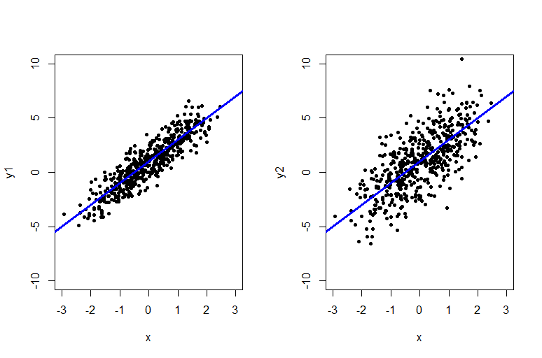
Uncertainty of Least Square Estimate

Slide 24
R
par(mfrow=c(1,2))
for (i in 1:100)
{
n=500
x=rnorm(n)
y1=1+2*x+rnorm(n)
y2=1+2*x+3*rnorm(n)
plot(x,y1,xlim=c(-4,4),ylim=c(-15,15),pch=20)
abline(a=1,b=2,col="gray",lwd=5)
abline(lm(y1~x),col="blue",lwd=3)
plot(x,y2,xlim=c(-4,4),ylim=c(-15,15),pch=20)
abline(a=1,b=2,col="gray",lwd=5)
abline(lm(y2~x),col="blue",lwd=3)
Sys.sleep(0.1)
}

Slide 25
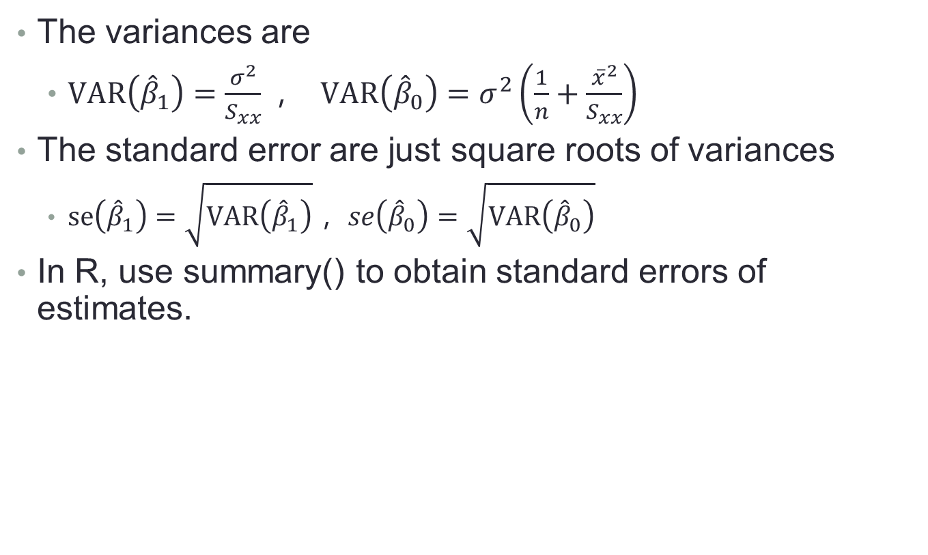
Variance and Standard Error of Least-Squares Estimation
The variances are
$VAR\left({\hat{β}}_{1}\right)=\frac{σ^{2}}{S_{xx}}，$ $VAR\left({\hat{β}}_{0}\right)=σ^{2}\left(\frac{1}{n}+\frac{{\overline{x}}^{2}}{S_{xx}}\right)$
The standard error are just square roots of variances
$se\left({\hat{β}}_{1}\right)=\sqrt{VAR\left({\hat{β}}_{1}\right)}， se\left({\hat{β}}_{0}\right)=\sqrt{VAR\left({\hat{β}}_{0}\right)}$
In R, use summary() to obtain standard errors of estimates.

Slide 26
Understanding of standard error
One of the most important concepts in linear regression.
Variation of your estimates.
Standard error (SE) measures the “accuracy” of the estimate. Small SE means more accurate.
“Wiggle room” or “leeway” for having approximately same quality estimate.

Slide 27
R
summary(model1)$coef
summary(model1)$coef[,2]

Slide 28
Hypothesis Testing on the Slope and Intercept
Hypothesis testing
Slope
Intercept
Confidence intervals
Slope
Intercept

Slide 29
Example
Suppose someone tell you the slope of the rocket propellant data set should be -10
Do you believe it?
Suppose you obtain the data, run the regression and get an estimate of slope of -37, now do you believe him?
What if your estimate is -11 instead of -37, do you believe him?
Hypothesis testing
H₀: β₁ = -10 H₁: β₁ ≠ -10

Slide 30
Use of t-tests
Slope
H₀: β₁ = β₁₀ H₁: β₁ ≠ β₁₀
Test statistic:
Reject H₀ if |t₀| >
Can also use the P-value approach

Slide 31
Use of t-tests
Intercept
H₀: β₀ = β₀₀ H₁: β₀ ≠ β₀₀
Test statistic:
Reject H₀ if |t₀| >
Can also use the P-value approach

Slide 32
Testing Significance of Regression
H₀: β₁ = 0 H₁: β₁ ≠ 0
This tests the significance of regression; that is, is there a linear relationship between the response and the regressor.
Failing to reject β₁ = 0, implies that there is no linear relationship between y and x

Slide 33
R code
# summary of hypothesis testing results
summary(model1)
# coefficient estimate
summary(model1)$coef[,1]
# standard error
summary(model1)$coef[,2]
# t value
summary(model1)$coef[,3]
# p value
summary(model1)$coef[,4]

Slide 34
Analysis of Variance
Partitioning of total variability

Slide 35
Analysis of Variance
Degrees of Freedom
Mean Squares

Slide 36
Analysis of Variance
ANOVA procedure for testing H₀: β₁ = 0
A large value of F₀ indicates that regression is significant; specifically, reject if F₀ >
Can also use the P-value approach

Slide 37
R Code
# F test and R square
anova(model1)
summary(model1)
# manual ways to calculate R and F test
SST=sum((y-mean(y))^2)
SSRes=sum((y-model1$fitted.values)^2)
SSR=sum((model1$fitted.values-mean(y))^2)
SSR+SSRes
SST
F=(SSR/1)/(SSRes/(n-2))
F

Slide 38
Example 2.1- Rocket Propellant Data

Slide 39
Analysis of Variance
Relationship between t₀ and F₀:
For H₀: β₁ = 0, it can be shown that:
So for testing significance of regression, the t-test and the ANOVA procedure are equivalent (only true in simple linear regression)

Slide 40
R
summary(model1)$coef[2,3]^2
summary(model1)

Slide 41
Interval Estimation in Simple Linear Regression
Instead of giving ONE estimate, i.e., point estimate.
Now we give a window estimate.
Pro: can capture uncertainty of the estimate
Con: more complex.
Interval estimation has the a similar flavor as standard error.

Slide 42
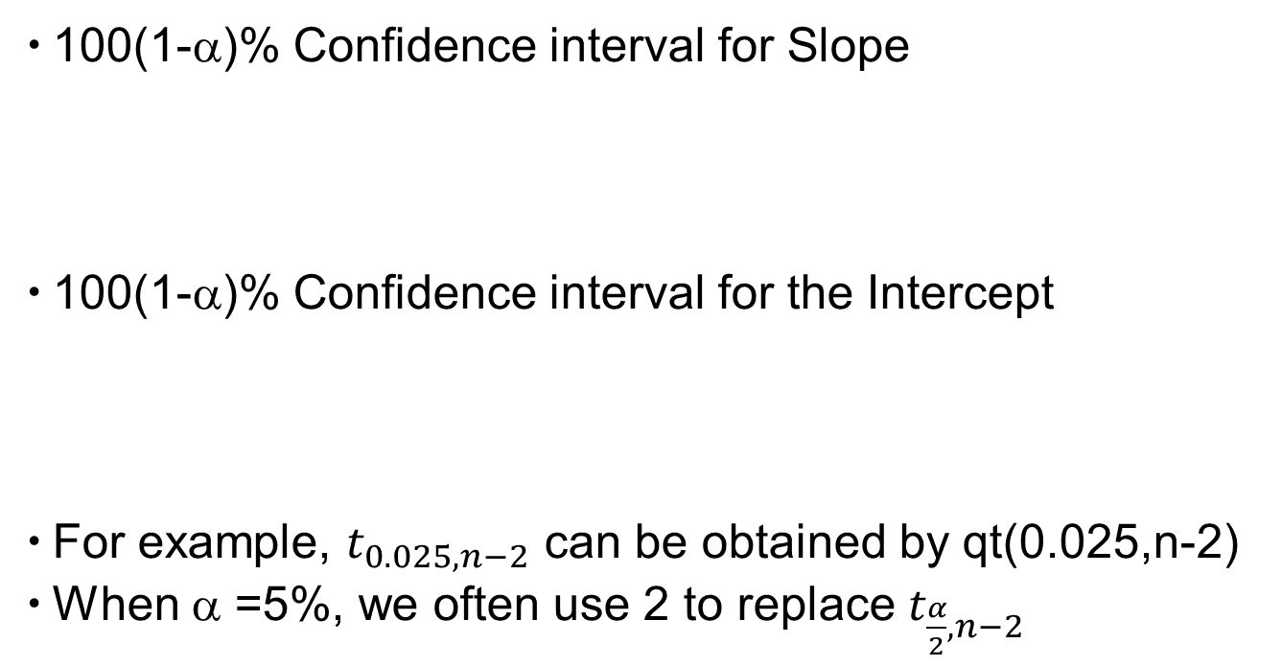
Interval Estimation in Simple Linear Regression
100(1-α)% Confidence interval for Slope
100(1-α)% Confidence interval for the Intercept
For example, $t_{0.025,n−2}$ can be obtained by qt(0.025,n-2)
When α =5%, we often use 2 to replace $t_{\frac{α}{2},n−2}$

Slide 43
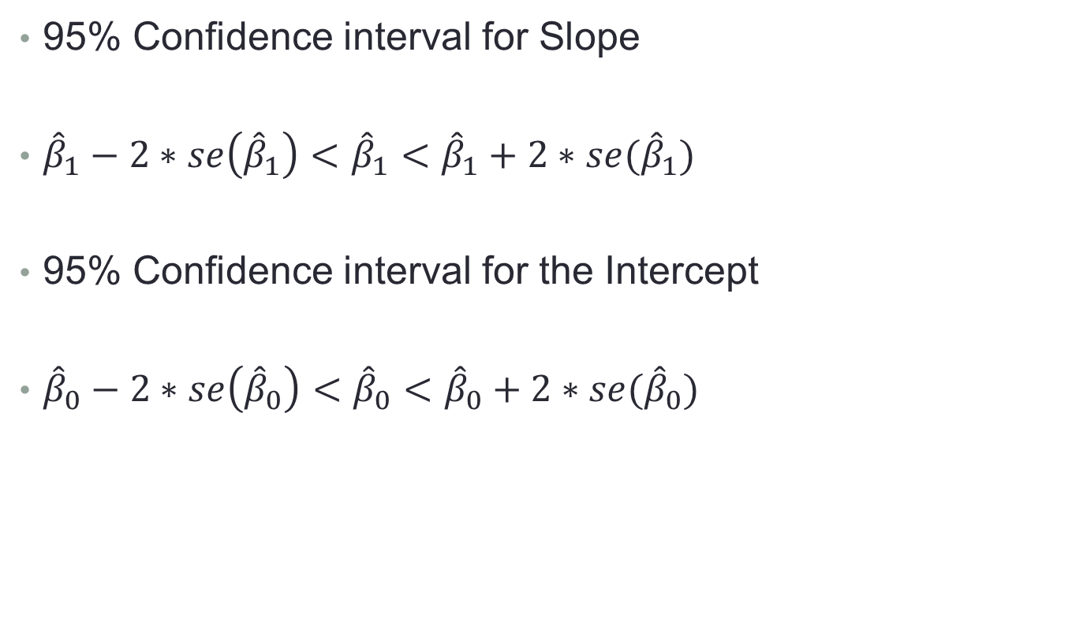
Simpler versions
95% Confidence interval for Slope
${\hat{β}}_{1}−2∗se\left({\hat{β}}_{1}\right)<{\hat{β}}_{1}<{\hat{β}}_{1}+2∗se({\hat{β}}_{1})$
95% Confidence interval for the Intercept
${\hat{β}}_{0}−2∗se\left({\hat{β}}_{0}\right)<{\hat{β}}_{0}<{\hat{β}}_{0}+2∗se({\hat{β}}_{0})$

Slide 44
R code
# CI for coef
confint(model1,level=0.95)
confint(model1,level=0.90)
confint(model1,level=0.99)

Slide 45
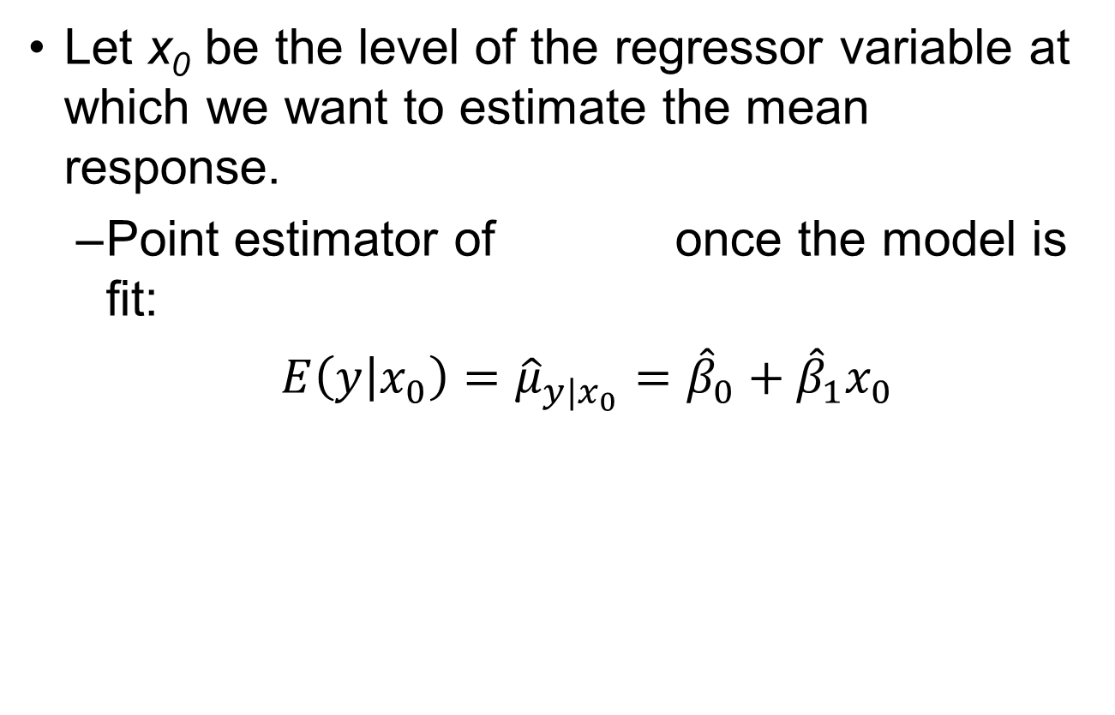
Interval Estimation of the Mean Response
Let x₀ be the level of the regressor variable at which we want to estimate the mean response.
Point estimator of once the model is fit:
$E\left(y | x_{0}\right)={\hat{μ}}_{y|x_{0}}={\hat{β}}_{0}+{\hat{β}}_{1}x_{0}$

Slide 46
Interval Estimation of the Mean Response
In R, use predict() to obtain interval estimation for mean response.

Slide 47
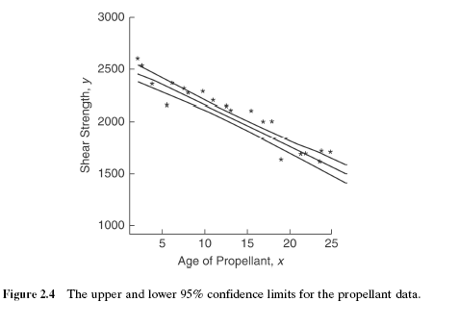
Example 2.1- Rocket Propellant Data

Slide 48
R code
# CI for mean response, prediction of new observation,
predict.lm(model1, interval="confidence") #make prediction and give confidence interval for the mean response
newx<-seq(0,30)
conf<-predict(model1,newdata=data.frame(x=newx),interval = c("confidence"),level = 0.95,type="response")
plot(rocket$x,rocket$y,pch=20)
model1 <- lm(y ~ x, data=rocket)
abline(model1,col="blue")
lines(newx,conf[,2],col="red",lty=2)
lines(newx,conf[,3],col="red",lty=2)

Slide 49
Coefficient of Determination
R² - coefficient of determination
Proportion of variation explained by the regressor, x
For the rocket propellant data

Slide 50
Coefficient of Determination
R² can be misunderstood:
A high coefficient of determination indicates that a useful prediction can be made.
A high coefficient of determination indicates that the estimated regression line is good fit.
A coefficient of determination near zero indicates that x and y are not related.

Slide 51
Coefficient of Determination
R² can be misleading:
Simply adding more terms to the model will increase R²
As the range of the regressor variable increases (decreases), R² generally increases (decreases).
R² does not indicate the appropriateness of a linear model

Slide 52
R code
# R square
summary(model1)$r.square
# manual way
SST=sum((rocket$y-mean(rocket$y))^2)
SSRes=sum((rocket$y-model1$fitted.values)^2)
SSR=sum((model1$fitted.values-mean(rocket$y))^2)
SSR+SSRes
SST
1-SSRes/SST

Slide 53
R summary
model <- lm(y~x)
#Coefficient estimate
model$coef
#Standard error
summary(model)$coef[,2]
#Fitted value
model$pred
#Residuals
model$res
#R square
summary(model1)$r.square
#Hypothesis testing, t test, F test.
summary(model1)
#Confidence interval
confint(model, level=0.95)

Slide 54
Data set 1
rm(list=ls())
d=read.csv("chicago.csv")
names(d)
attach(d)
plot(x,y)
model2=lm(y~x)
summary(model2)
abline(model2)
library(HH)
ci.plot(model2)
anova(model2)
confint(model2,level=0.95)
plot(model2$residuals,pch=20)
abline(h=0)
points(model2$residuals,type="h")
detach(d)

Slide 55
Data set 2
rm(list=ls())
d=read.csv("delta.csv")
names(d)
names(d)[5]="Time"
names(d)[6]="Dist"
attach(d)
plot(Dist,Time,pch=20)
model3=lm(Time~Dist)
summary(model3)
abline(model3)
lines(lowess(Time~Dist))
library(HH)
ci.plot(model3)
anova(model3)
confint(model3,level=0.95)
plot(model3$residuals,pch=20)
abline(h=0,col="red",lwd=3)
detach(d)

Slide 56
Data set 3
rm(list=ls())
d=read.csv("vote.csv")
names(d)
names(d)[3]="Unlikeness"
names(d)[4]="Percentage"
pairs(d)
attach(d)
plot(Congress,Beginning.Year)
plot(Unlikeness,Percentage,pch=20)
model4=lm(Percentage~Unlikeness)
summary(model4)
abline(model4)
lines(lowess(Percentage~Unlikeness))
library(HH)
ci.plot(model4)
anova(model4)
confint(model4,level=0.95)
plot(model4$residuals,pch=20)
points(model4$residuals,type="h")
abline(h=0,col="red",lwd=3)

